Slide 1
Bean experiment

Slide 2
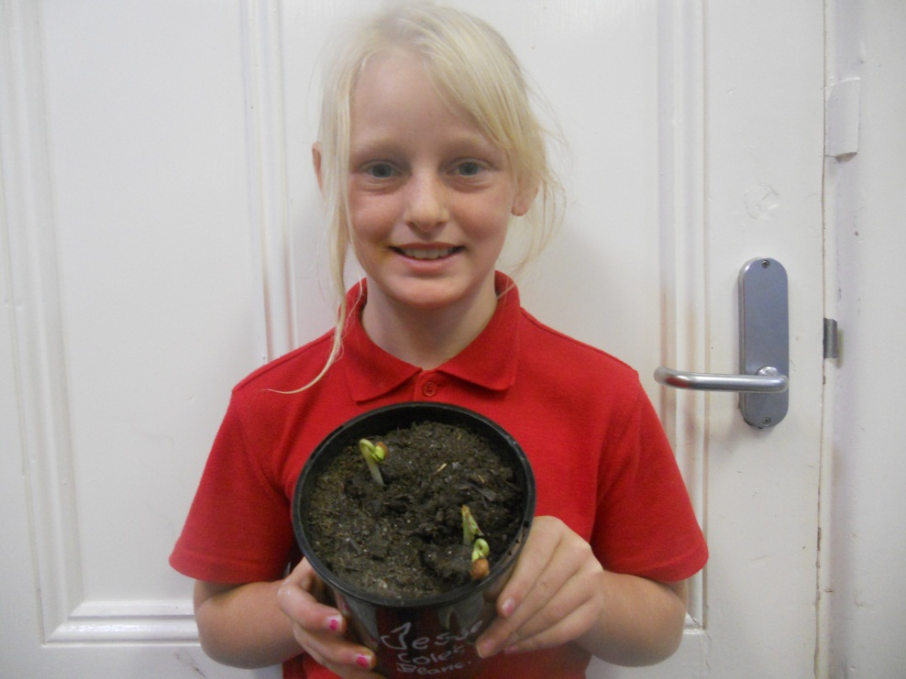
week one
Week one I sat the beans into Mrs Farleys office

Slide 3
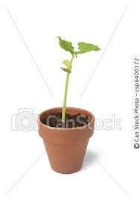
Week two
My beans have grown about 15 cm tall
With out watering them.

Slide 4
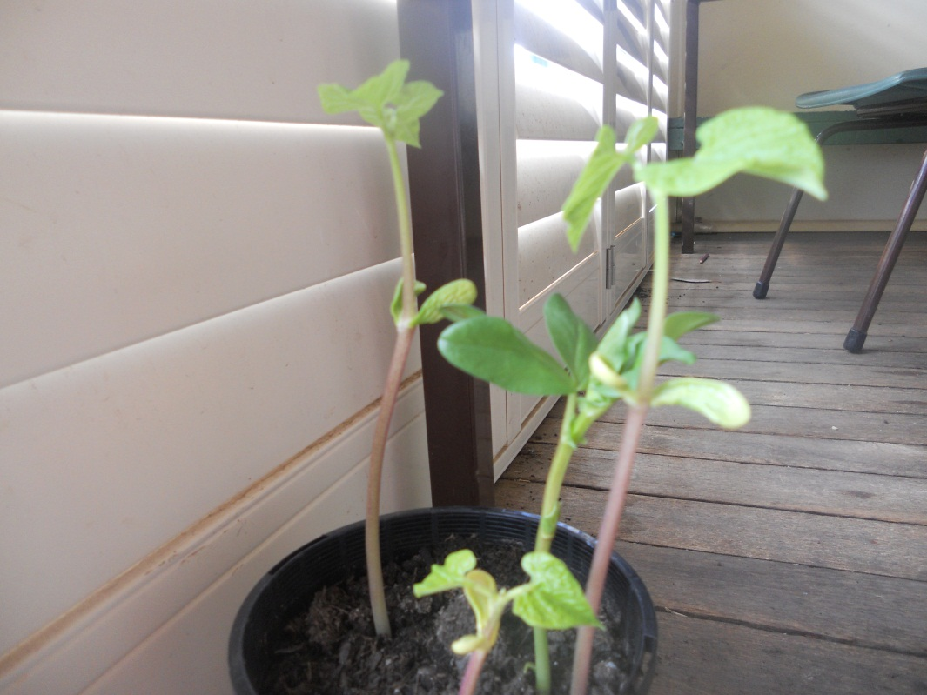
Week three
My beans are going really well they have grown up to 22 cm tall

