Slide 1
Broad Beans
Made by Aleea And Liam Cole Lachlan.

Slide 2
How long is the bean? And how long have we had the bean?
This bean is 1cm tall.
This is a broad bean.
We have had this bean ever since the 20th of May.

Slide 3
Where did you put the bean?
This bean is a shoot as it is coming up. This bean is growing good.
We put the beans in the sun where they can grow
One hint: you can never water the plants at the top because they will not get enough oxygen to breathe when there could die.
This bean has been growing is the garden near the house. This bean is getting water every day and is also being happy all the time.
This bean has been extremely healthy all the time.
This bean can be a good healthy one too!

Slide 4
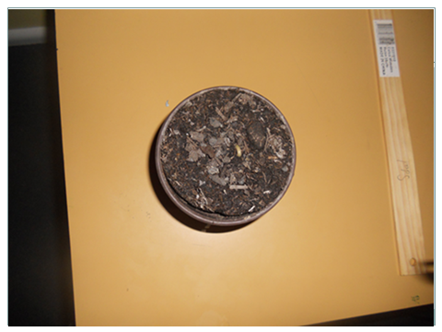
How to take care of the beans
1.You get the bean and you plant the bean 5cm down (as bag as your pinkie).
2.You plant them and then you get some water and put some in.(make shore that you don’t put in the water in too fast.
3.The last step. You water the plants everyday and you don’t move the plant around a lot because they will die. So be careful!

Slide 5
Climbing beans

Slide 6
Week one | Nothing happee

