Slide 1
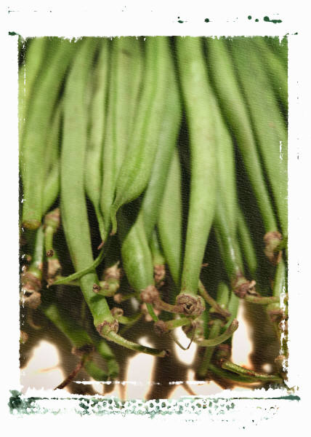
Have planted we beans at was the 20/5/13 now it is the 5/6/13.We have not water our beans for a week.

Slide 2
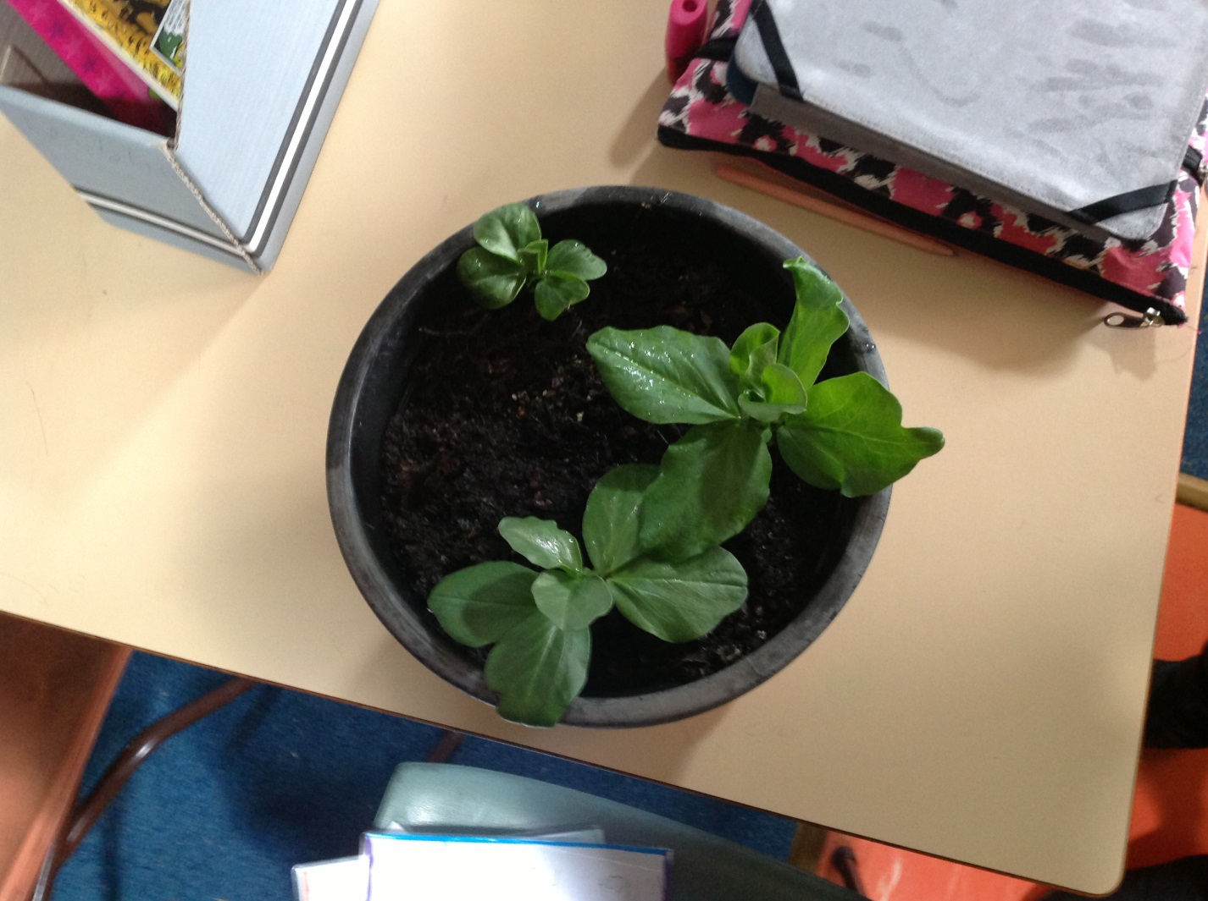
This is Claudia and jasmine, beans project.

Slide 3
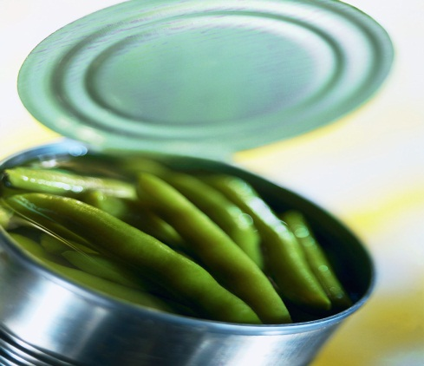
Big Beans
Hi Mr Grossest. I called it Big Beans because my beans are so big one is 20cm the over one is 21cm and the over one is 19cm . The people in my group are Claudia jasmine.

Slide 4
Claudia jasmine bean diary
Our beans are going good .

Slide 5
facts
One of the days our beans are going good

Slide 6
How great are they
31cm is at is at.

