Slide 1
been
It has been 2 week since at we have planted our beans at was the 20/5/13 now it is the 5/6/13.we have not water our beans for a week

Slide 2
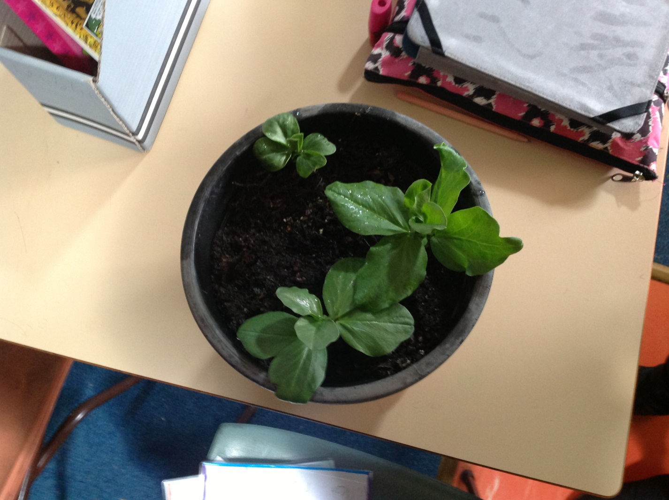
This is jazmine Claudia beans project.

Slide 3
Big Beans
Hi Mr Grossest. I called it Big Beans because my are so big one is 20cm the over one is 21cm and the over one is 19cm . The people in my group are jasmine and Claudia

Slide 4
Jasmine and Claudia bean diary
The beans have grown 8 more cm 2 more cm and one have not grown it is still germnating .

