Slide 1
Bean experiment

Slide 2
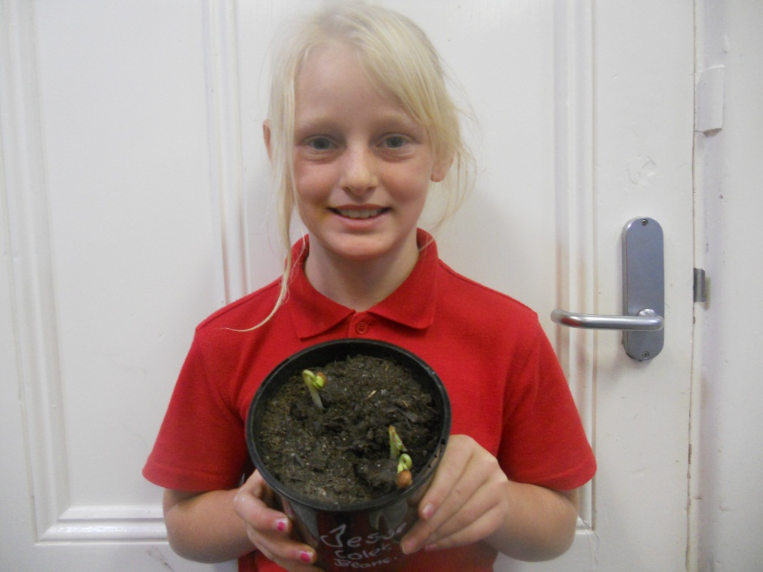
week one
Wee4k one I sat the beans into mrs farleys office

Slide 3
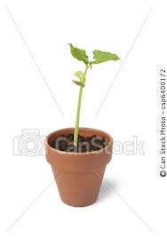
Week two
My beans have grown about 15 cm tall
With out watering them.

Slide 4
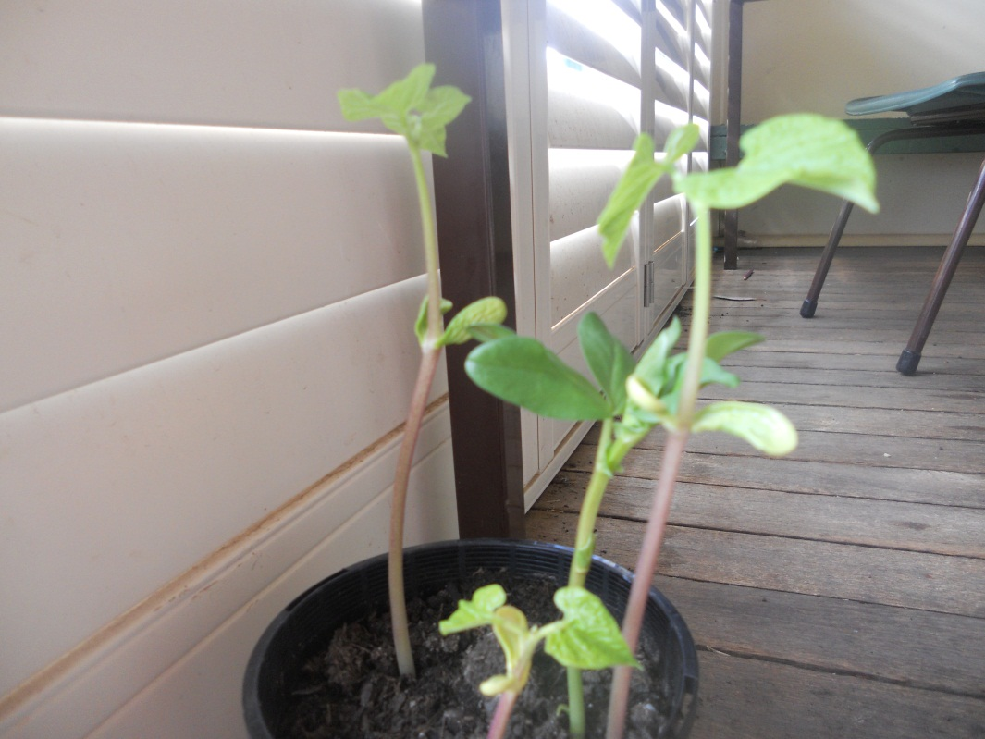
Week three
My beans are going really well they have grown up to 22 cm tall

Slide 5
Two of my beans have died and now my bean is alot more successful than it use to be.
The tallest one is now 34 centimetres on the next slide there is a photo of my bean. Some ants are getting onto my beans
.

Slide 6
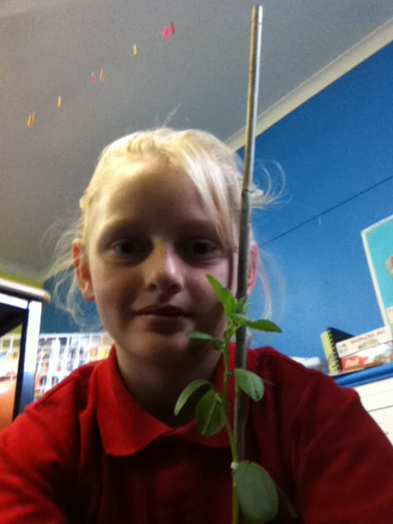
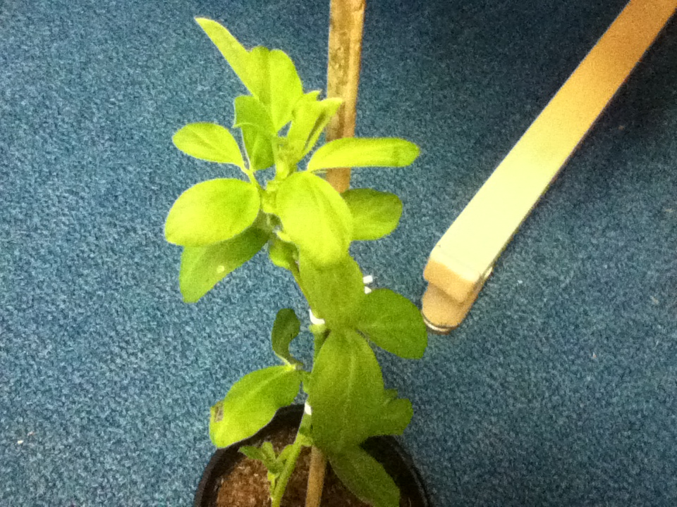
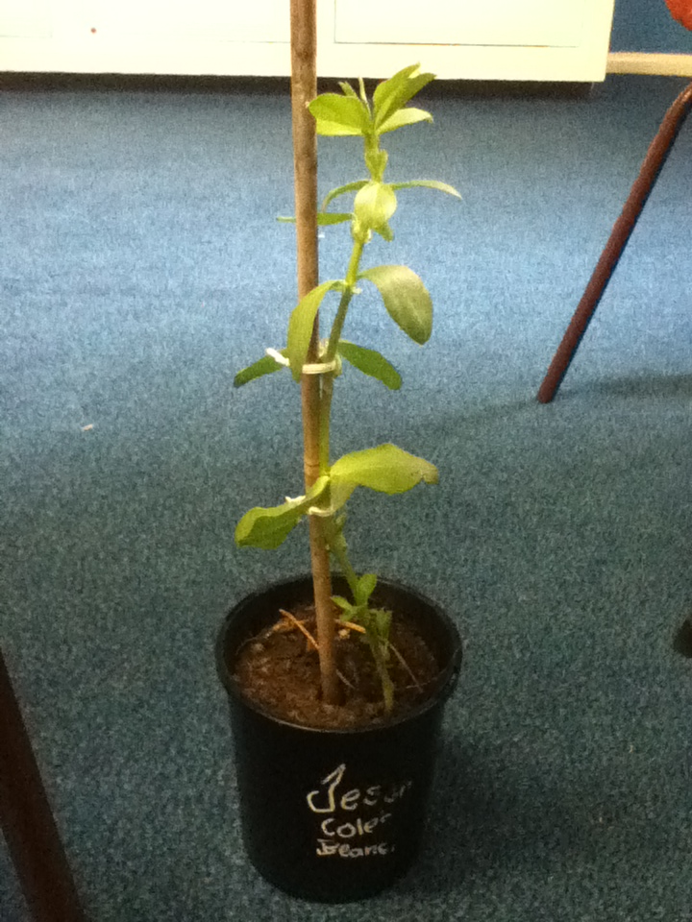
My beans

