Slide 1
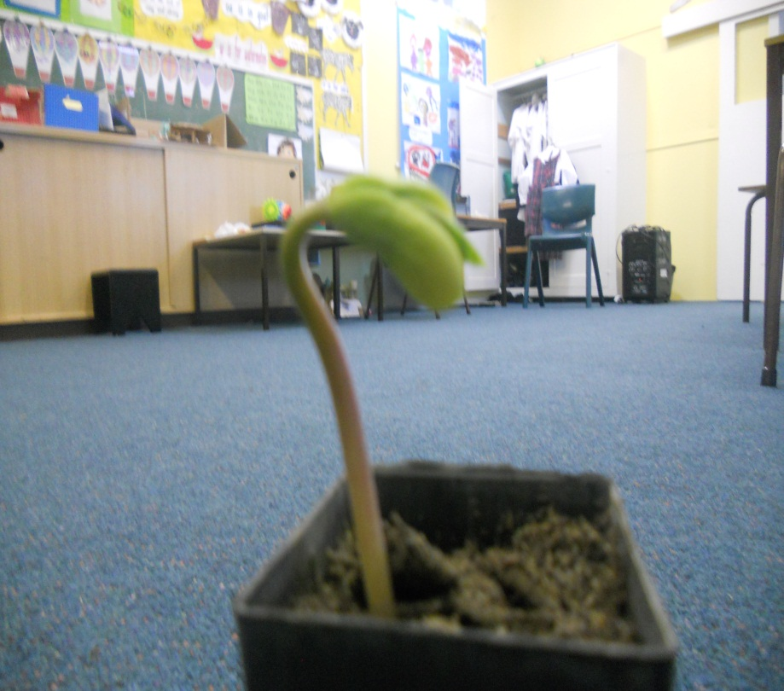
THE GREAT BEAN PROJECT

Slide 2
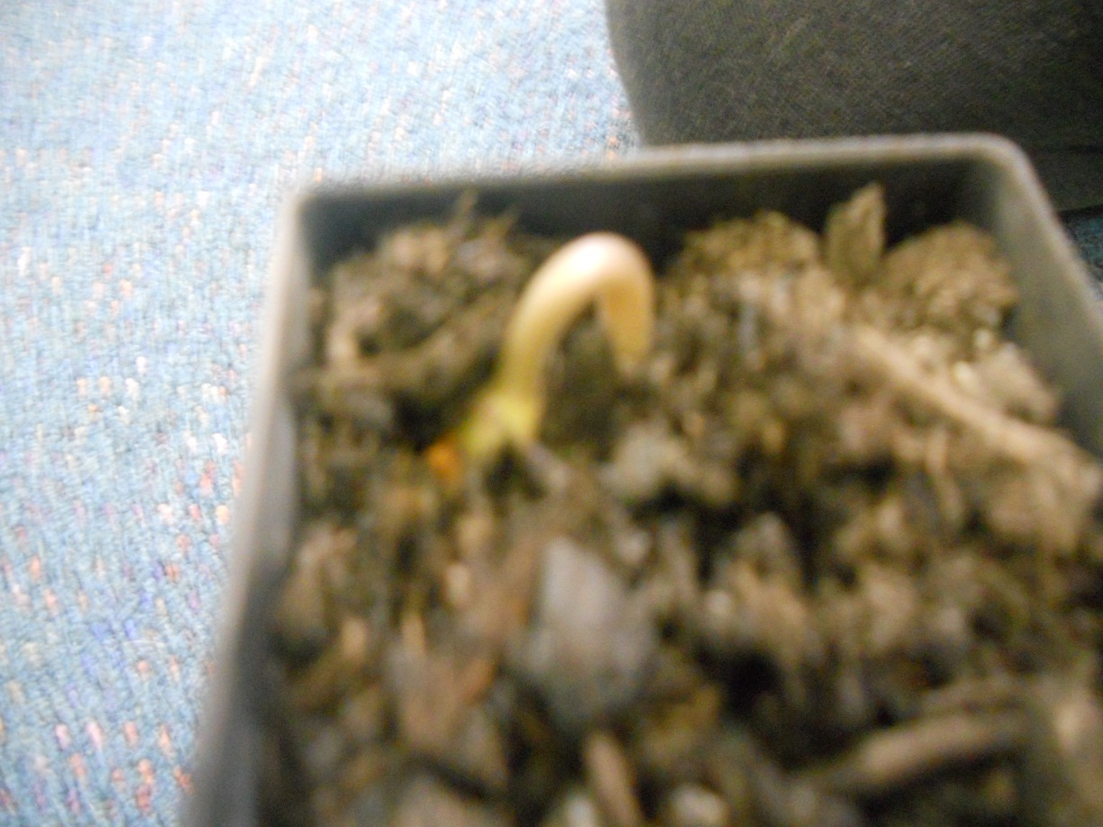
DAY ONE
Day 1 | We planted our beans and we put three climbing beans and one broad bean in four twelve centimetre pots.

Slide 3
DAY 2
Day 2 | On day two Andy, Aidan and I forgot our beans and it just grew by itself without water for two whole weeks.

Slide 4
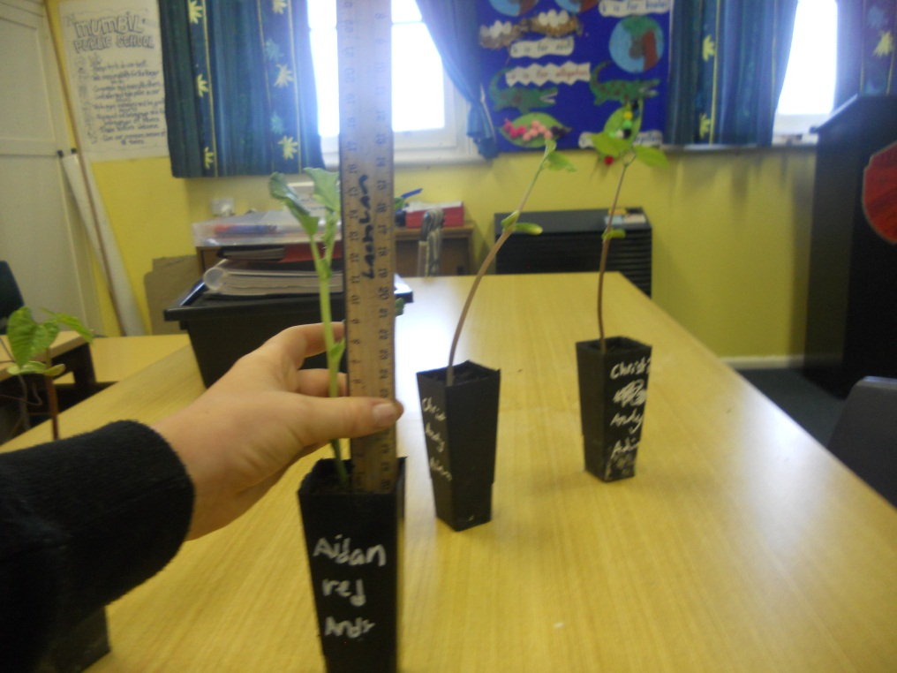
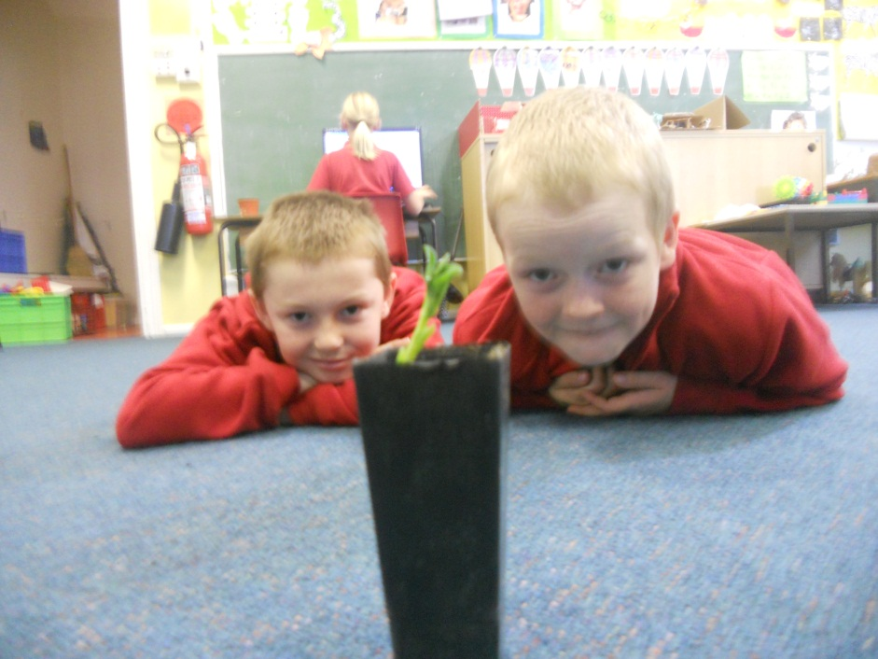
Day 17
Every day our beans have been growing 5 cm each day.
This is what the beans look like today 11/06/13 ^^^

